Slide 1
Bald Eagle Village A Computer Graphics Project
Yang Xikun, Lam Hei-Wai, Chau Ping-yin

Slide 2
Basic Requirements

Slide 3
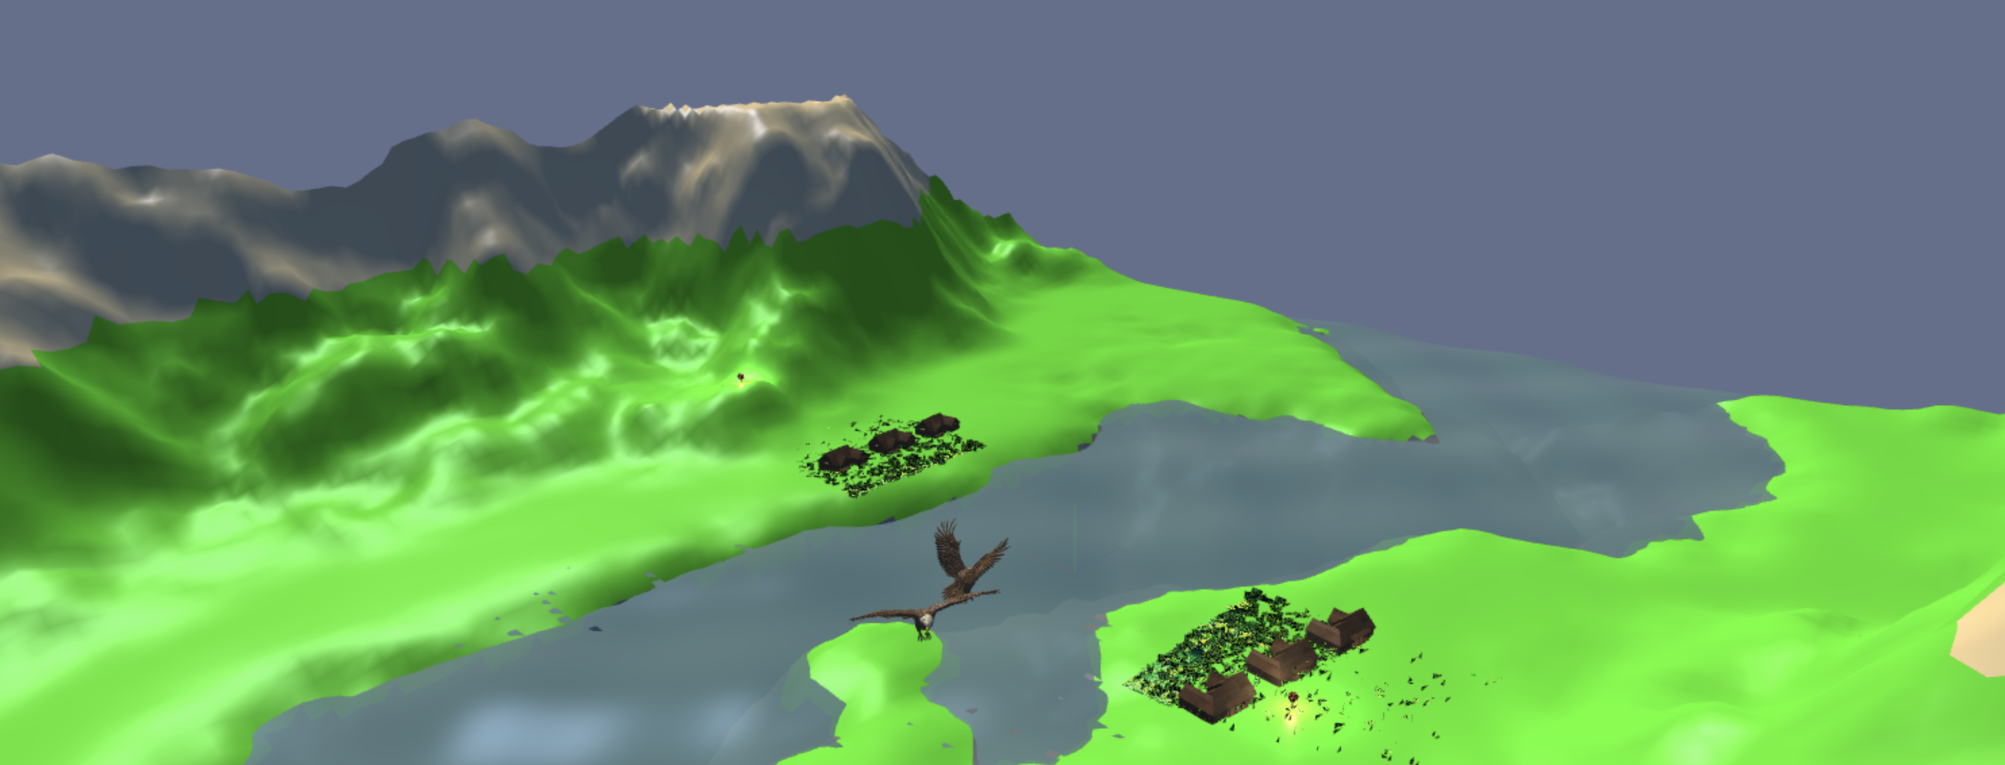
Basic Scene Setup Implement a ground plane or environmental base
Our ground plane is the terrain.

Slide 4
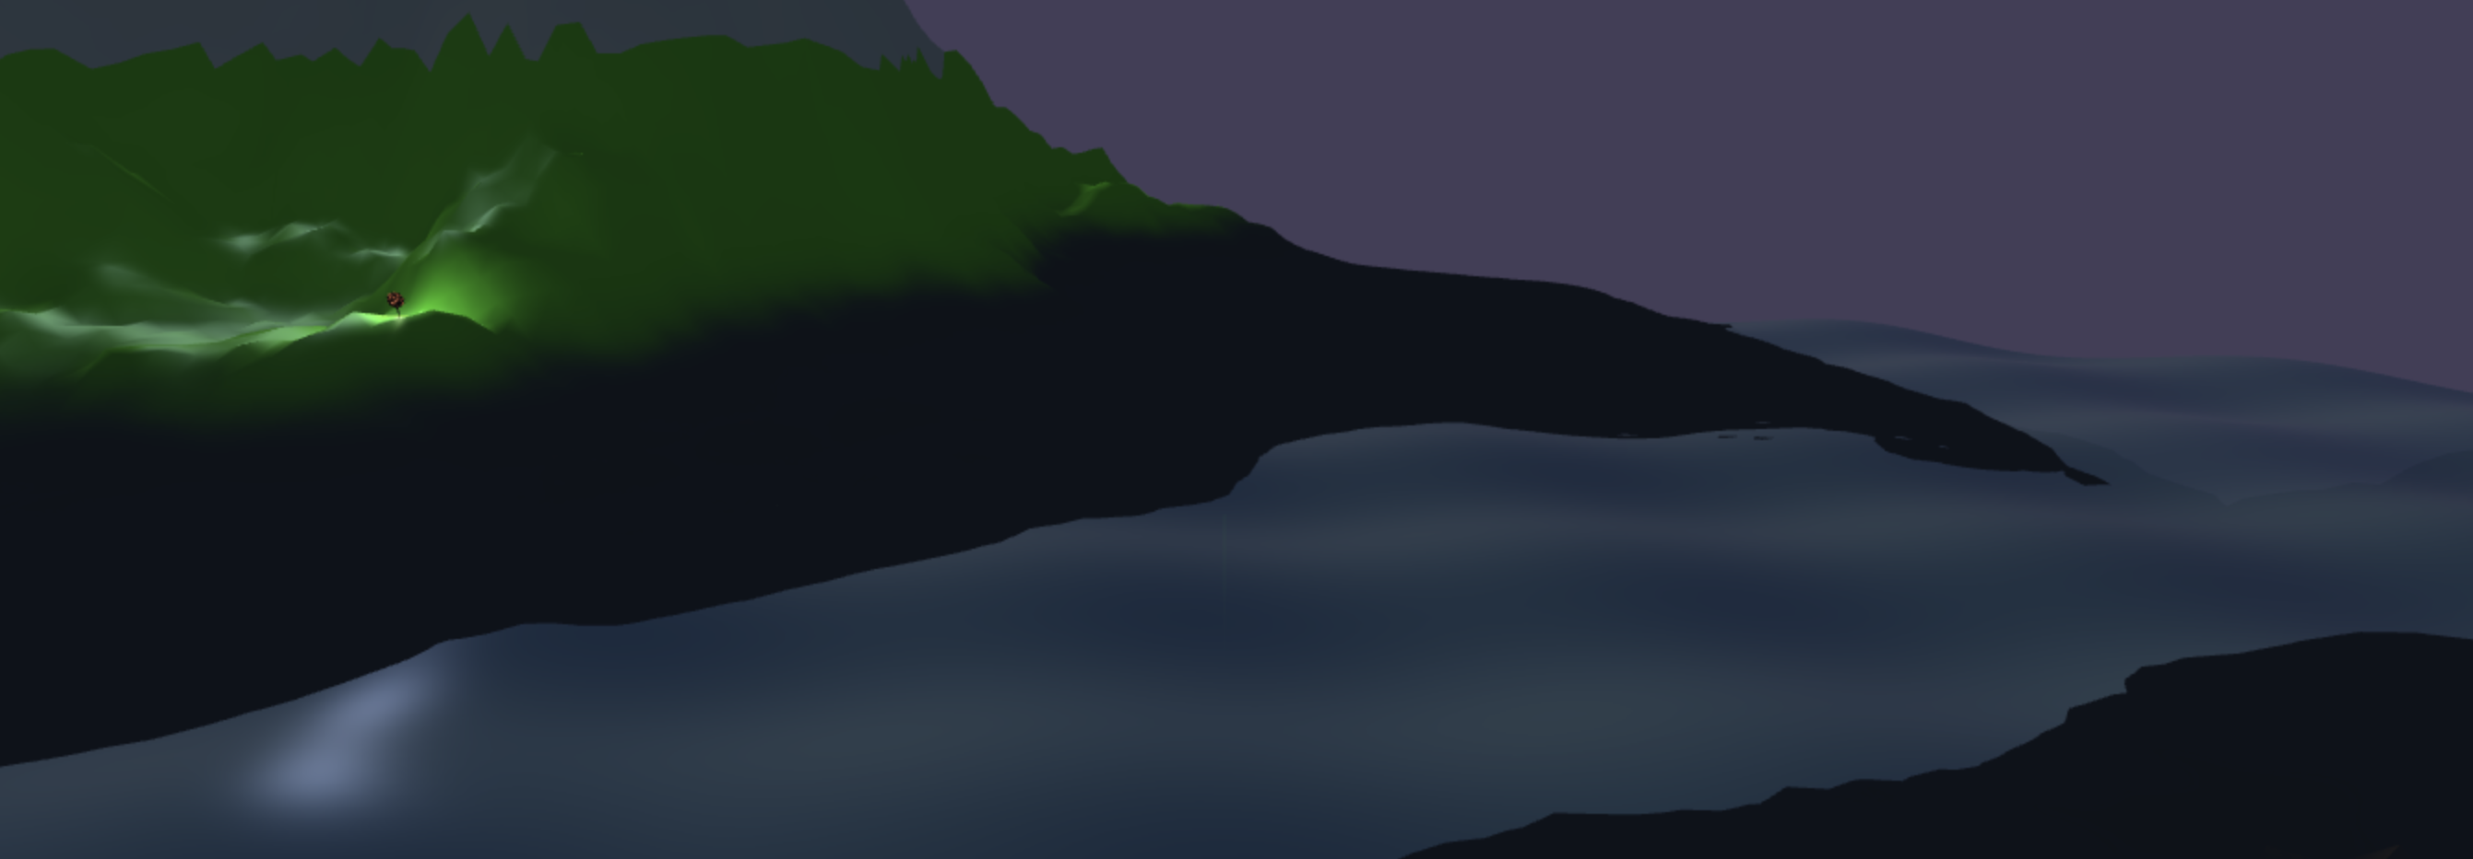
Basic Scene Setup Add background elements
Dynamic sky color change (sunrise animation)
Fog

Slide 5
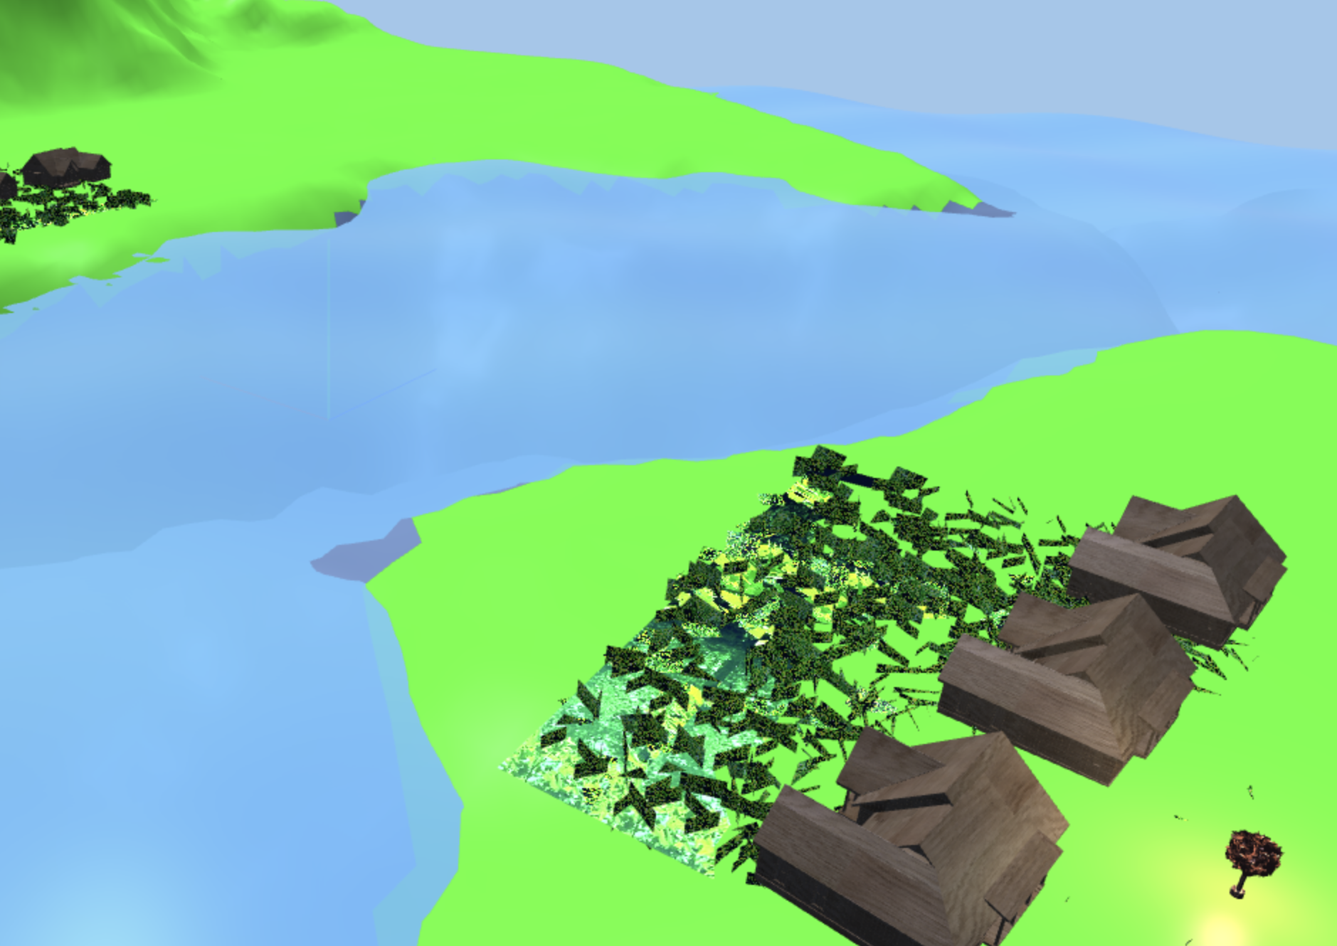
Basic Scene Setup Position objects thoughtfully to compose the scene
We designed an Alaska Village with Houses, Grass Lawns, and Street Lamps (Lamptrees)

Slide 6
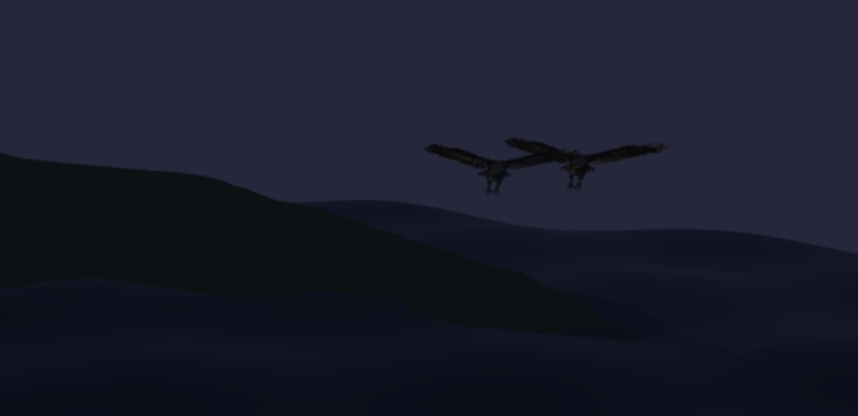
Basic Animation Translation (moving objects through space)
Two bald eagles glide in the fog.

Slide 7
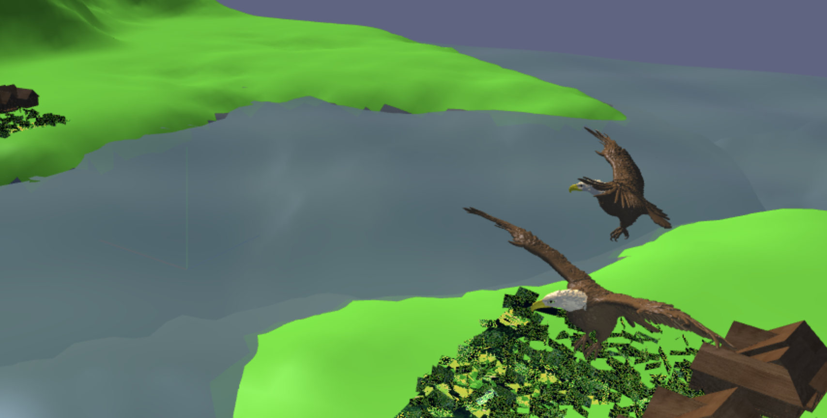
Basic Animation Rotation (spinning, orbiting, or turning objects)
The bald eagles circle around the center of the scene, chasing each other.

Slide 8
Basic Animation Scaling (growing, shrinking, or pulsating objects)
We scale the bald eagle wings along the X-axis.
In the code, we use the variable xCompressRatio ∈ [0, 1] to represent the amount of X-axis compression applied to both wings.
When the wings flap, their positions are scaled according to xCompressRatio, which naturally moves the wings closer to the center and thus closer to the body, making gaps less likely to appear.

Slide 9
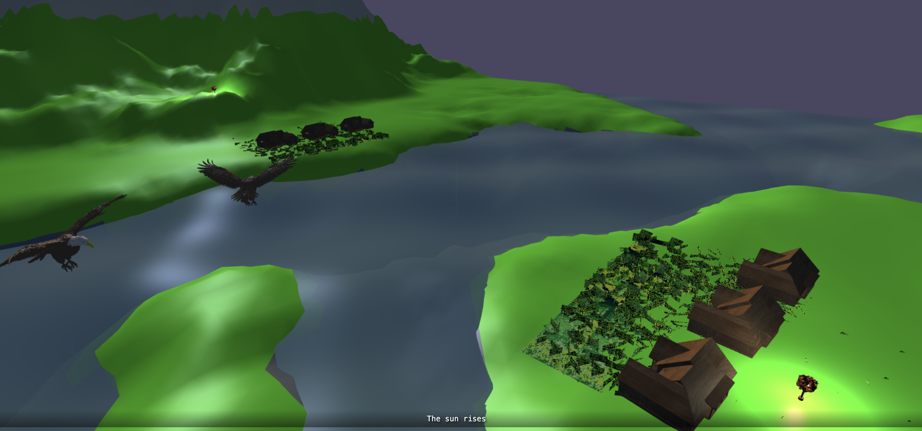
Lighting & Shading Ambient Light + Directional Light + Point Lights

Slide 10
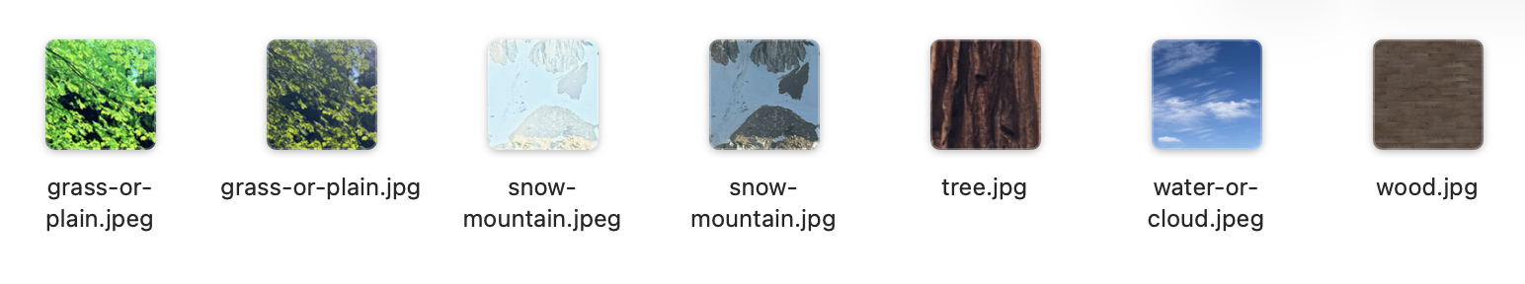
Textures

Slide 11
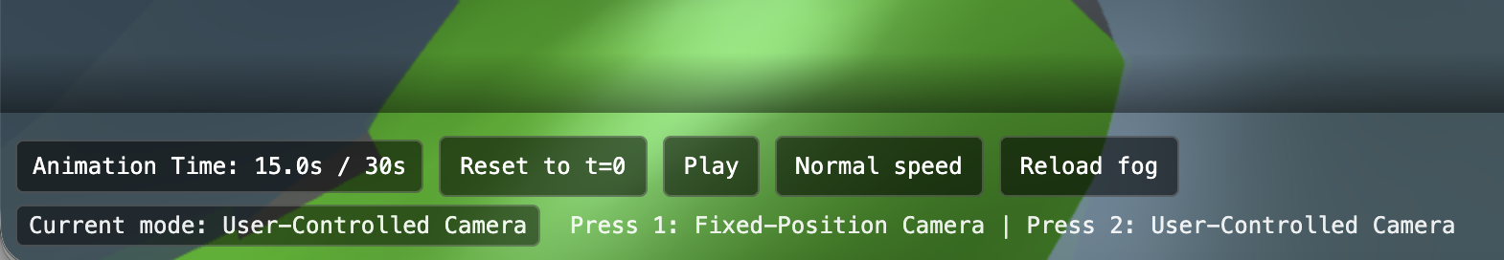
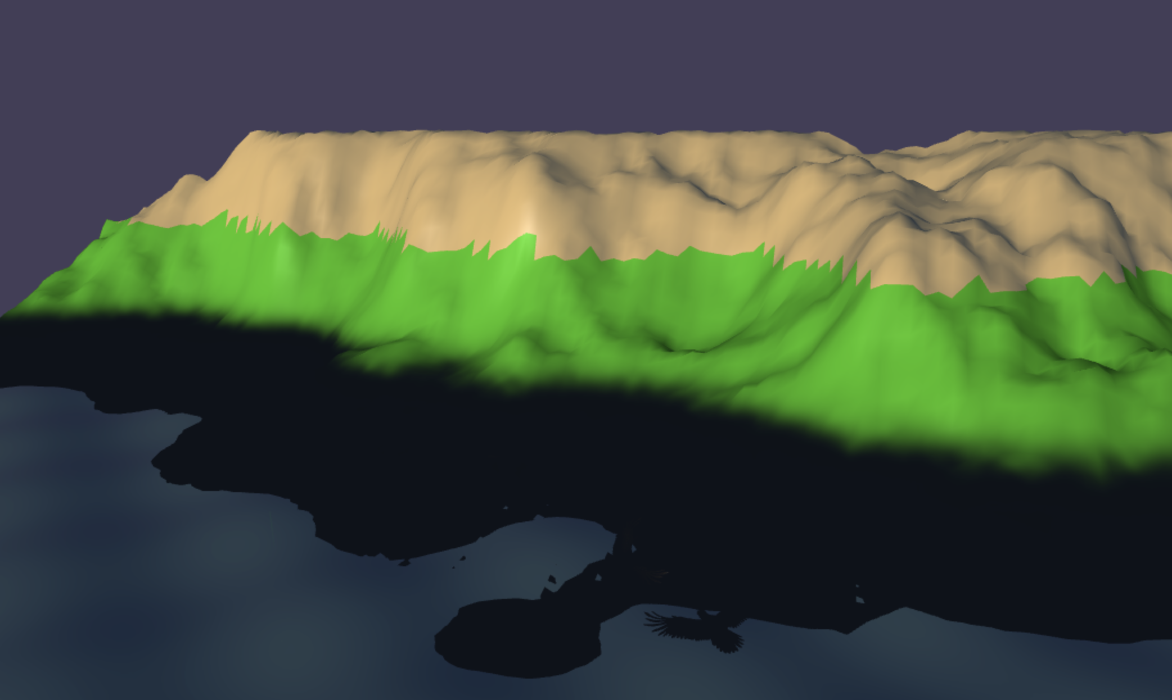
Camera Controls Fixed Control + User Free Control

Slide 12
Middle Level Requirements

Slide 13
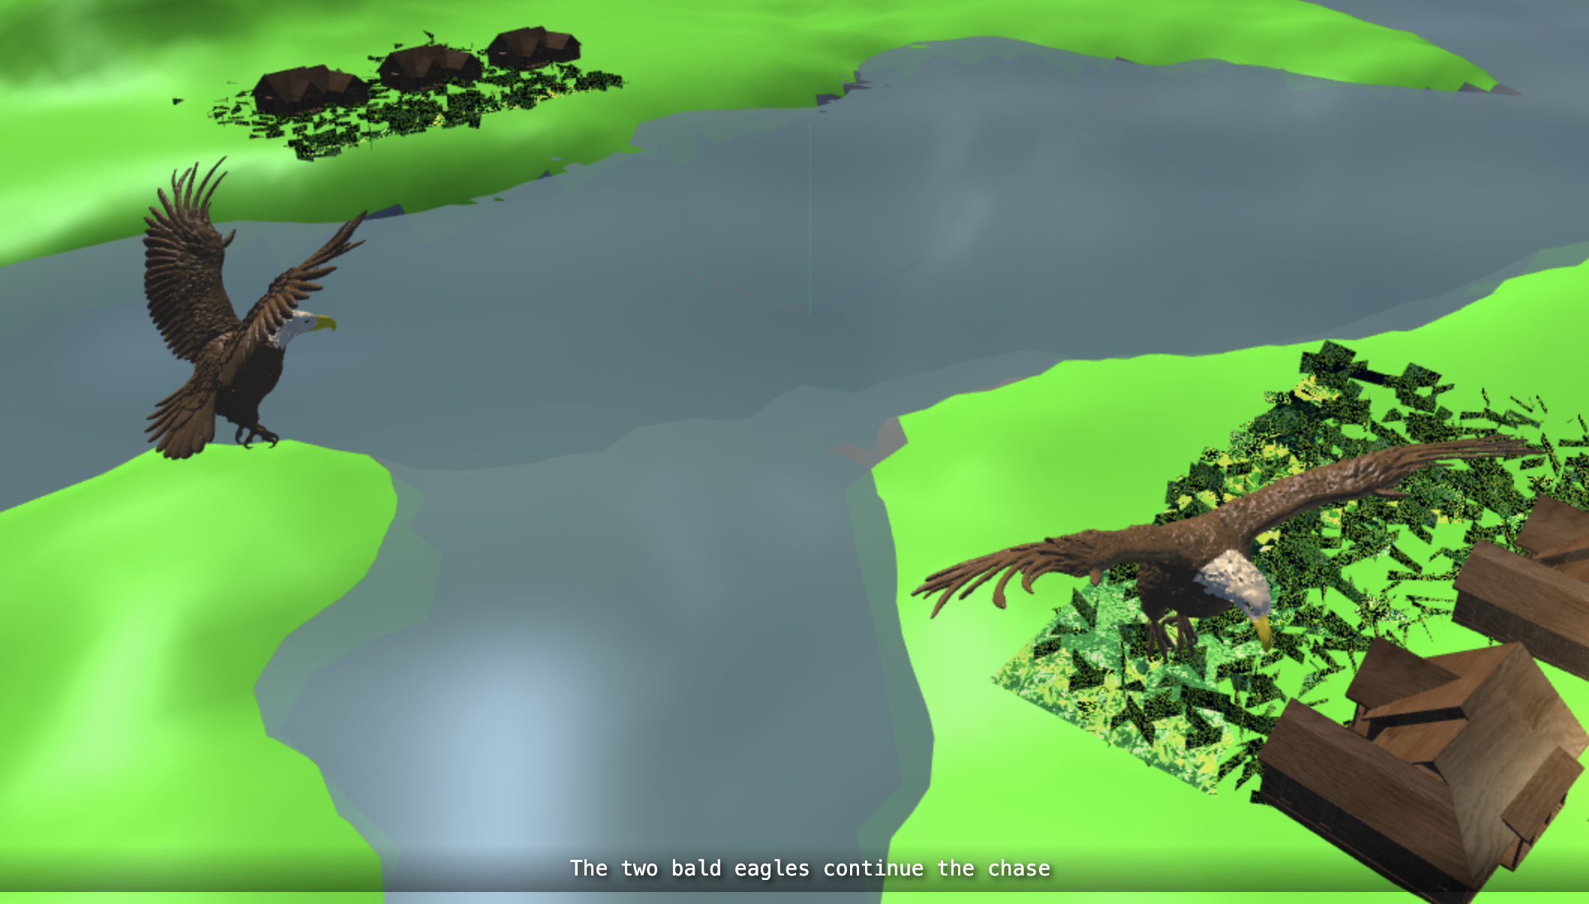
Object Interaction Animation Objects responding to other objects’ movements: Bald Eagles Chase Each Other

Slide 14
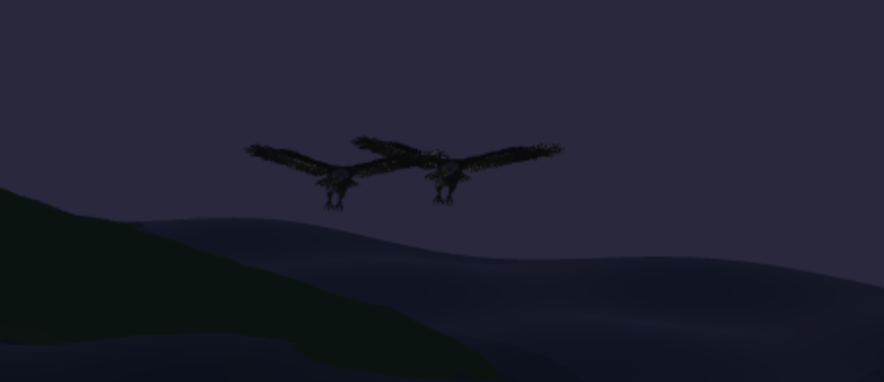
Object Interaction Animation Synchronized movements showing relationships

Slide 15
Object Interaction Animation Sequential animations creating cause-and-effect narratives

Slide 16
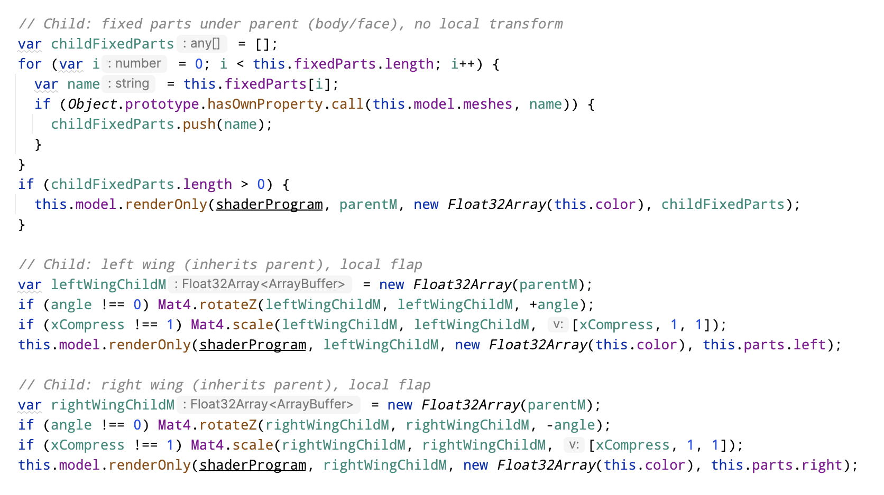
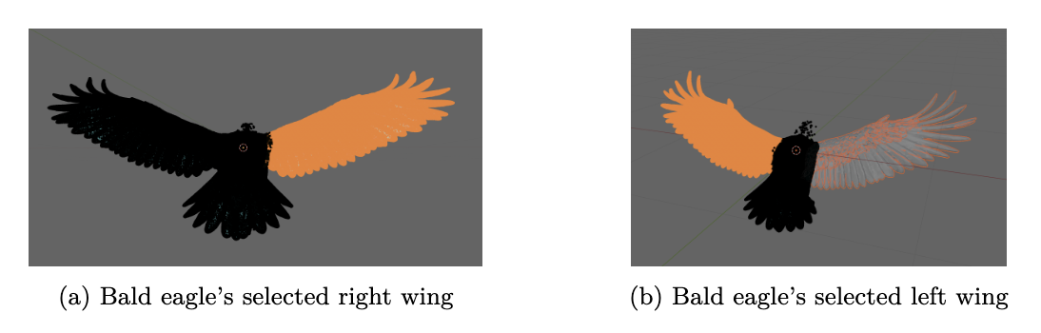
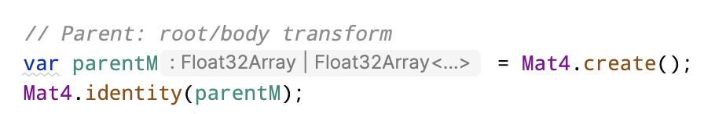
Hierarchical Transformations
Parent
Base Matrix
Chilren
Body
Left Wing
Right Wing

Slide 17
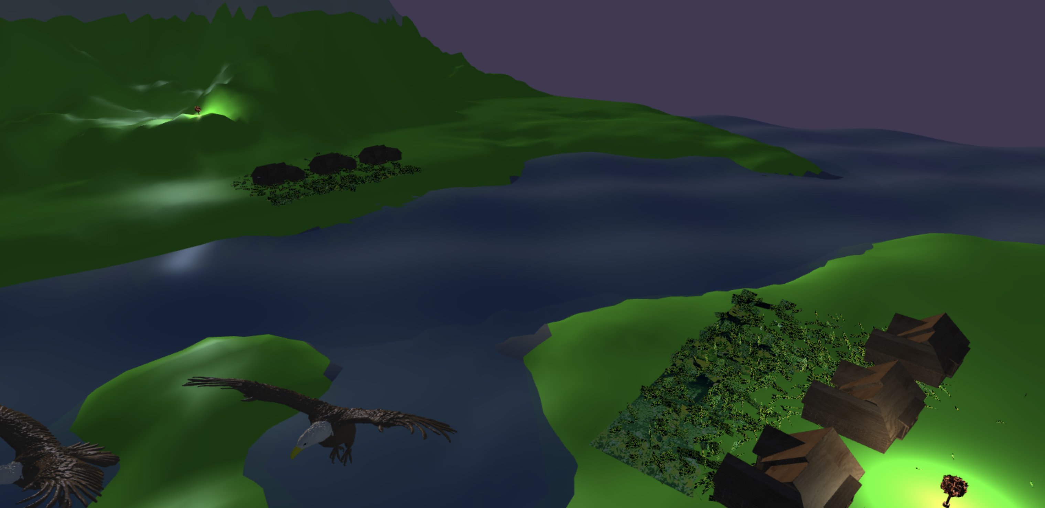
Enhanced Lighting
Ambient Light + Directional Light + Point Lights
Material Lights (Terrain, Water)
Sunrise Dynamic Lights

Slide 18
Visual Coherence
The Alaska Village

Slide 19
Advanced Level Requirements

Slide 20
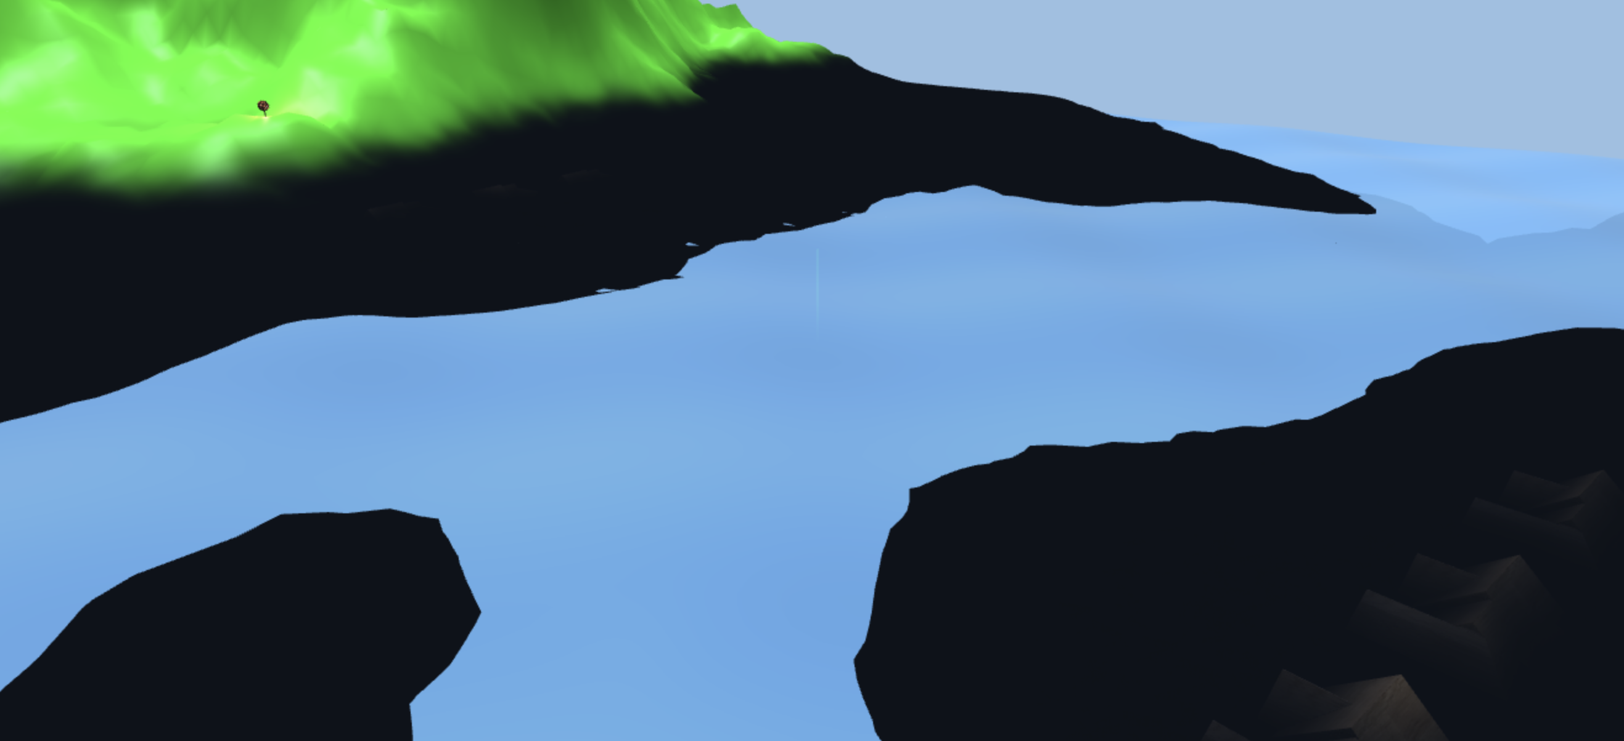
Advanced Visual Effects (Any 2) Fog and atmospheric effects

Slide 21
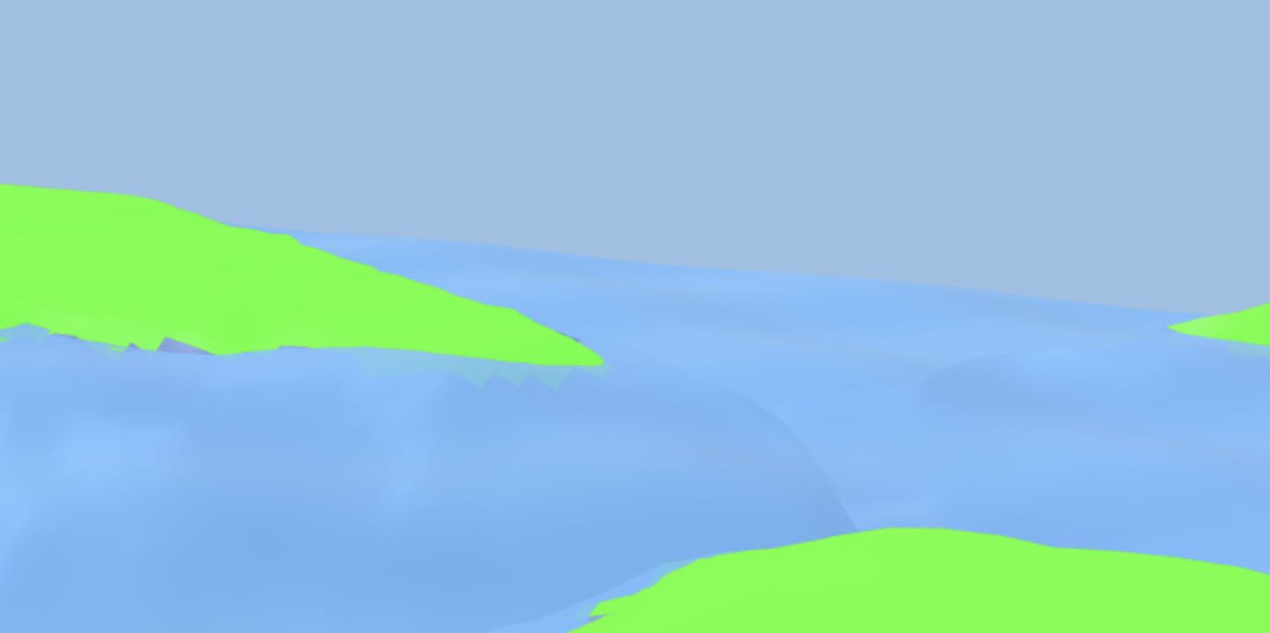
Advanced Visual Effects (Any 2) Water Reflection

Slide 22
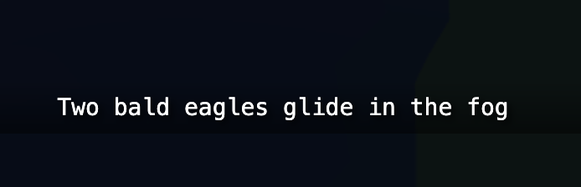
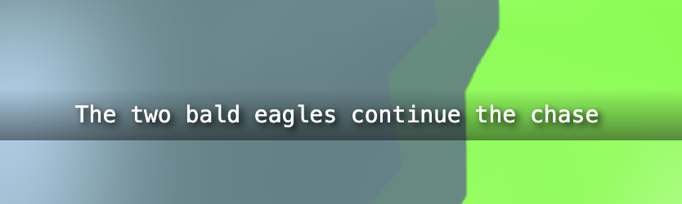
Storytelling Excellence Clear narrative arc with beginning, middle, and end

Slide 23
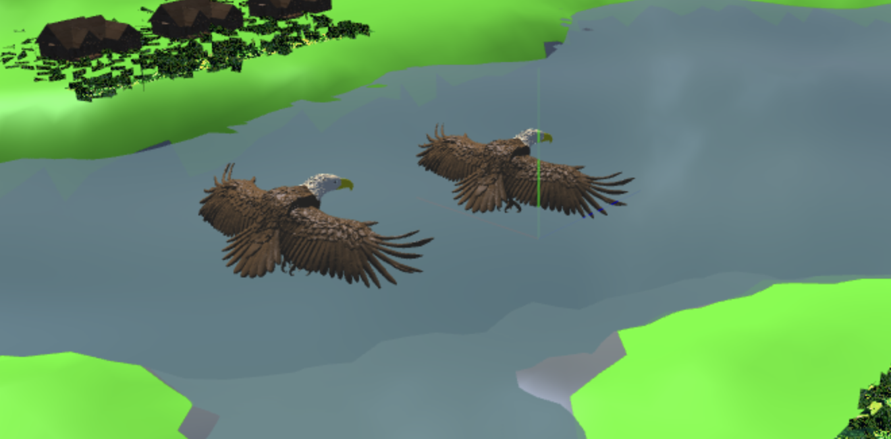
Storytelling Excellence Visual storytelling through object behavior and interaction

Slide 24
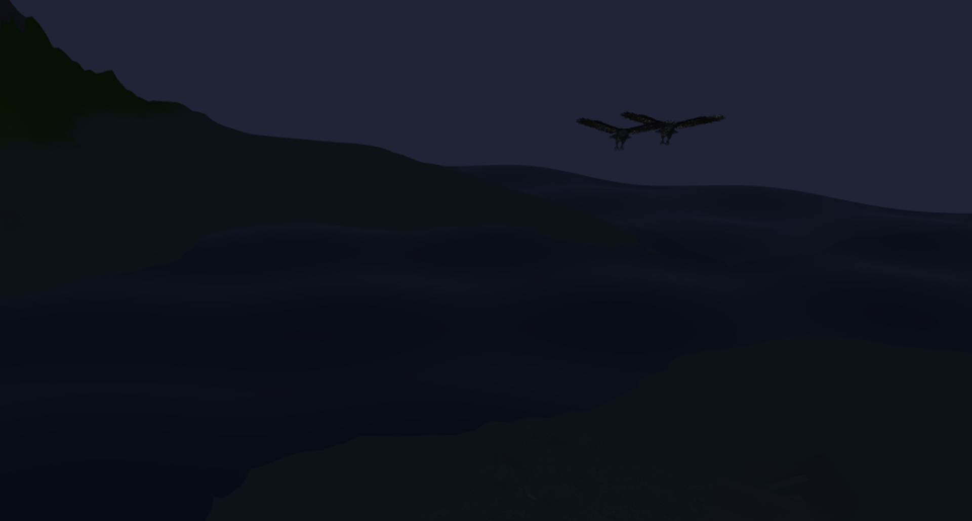
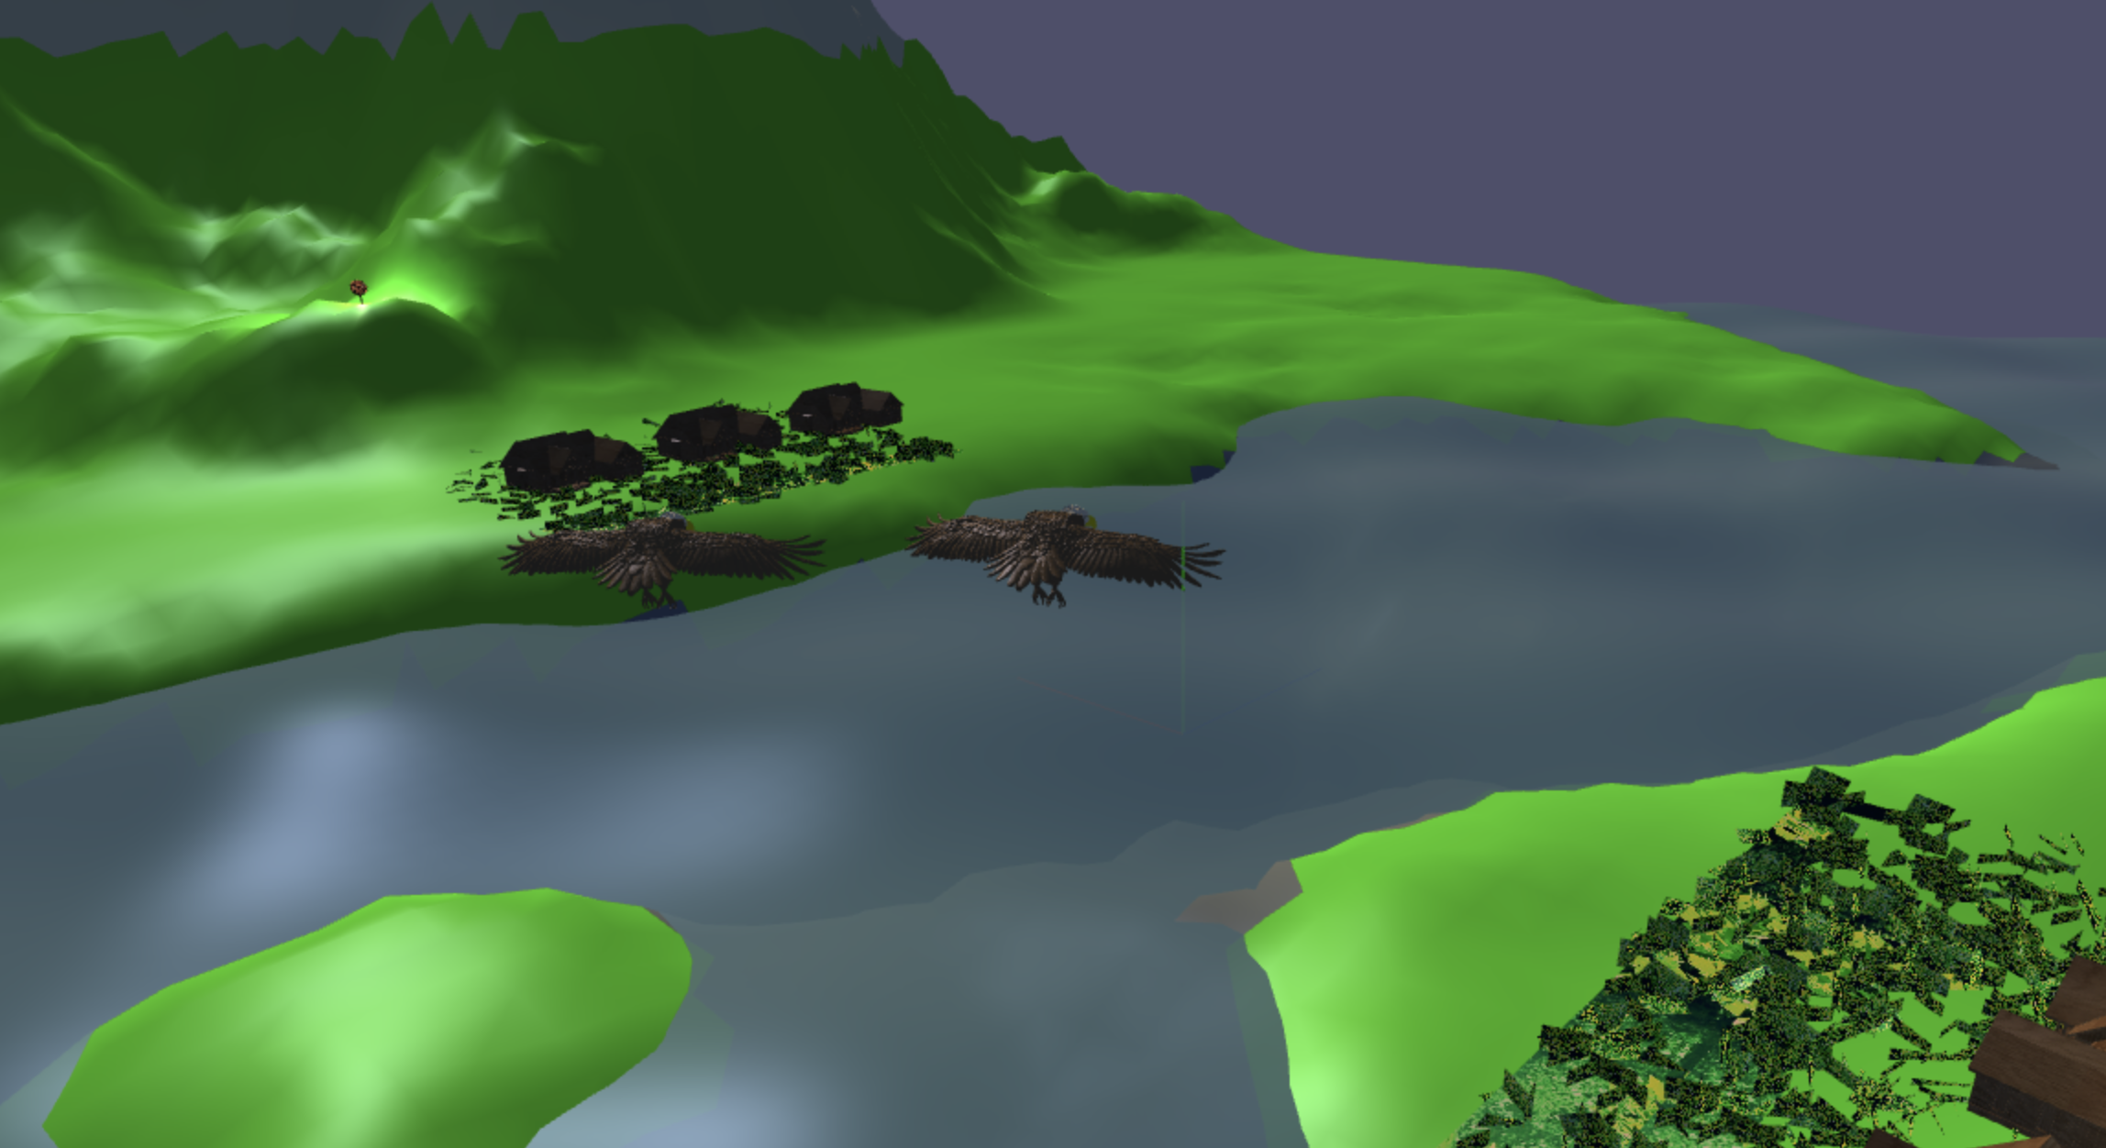
Storytelling Excellence Effective use of pacing, timing, and dramatic moments

Slide 25
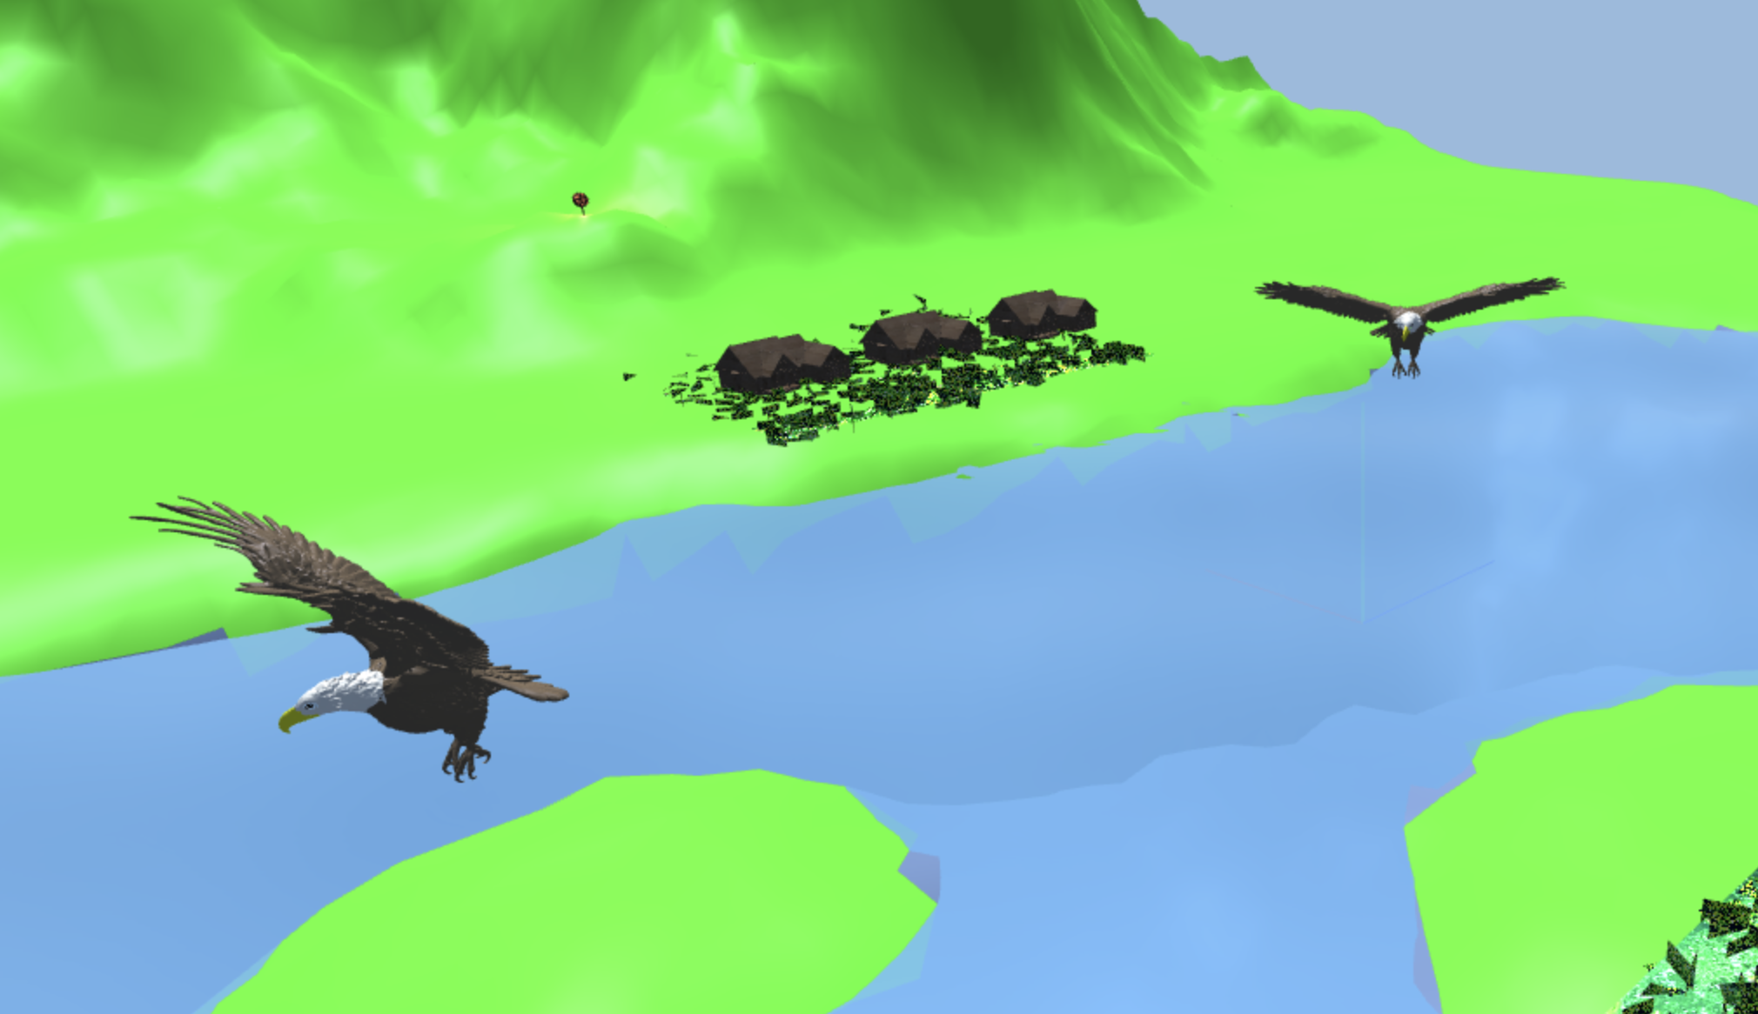
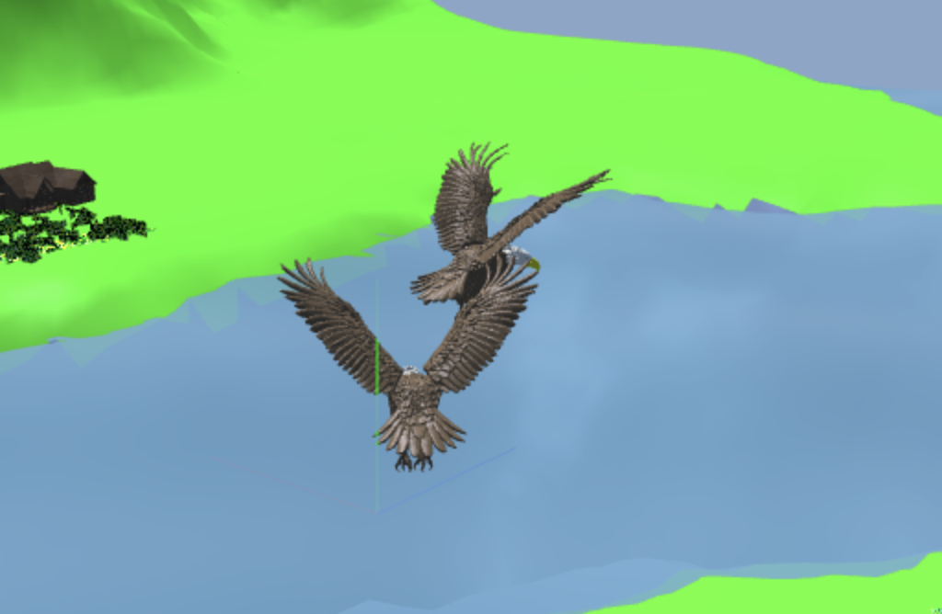
Storytelling Excellence Emotional impact or viewer engagement through visual composition

Slide 26
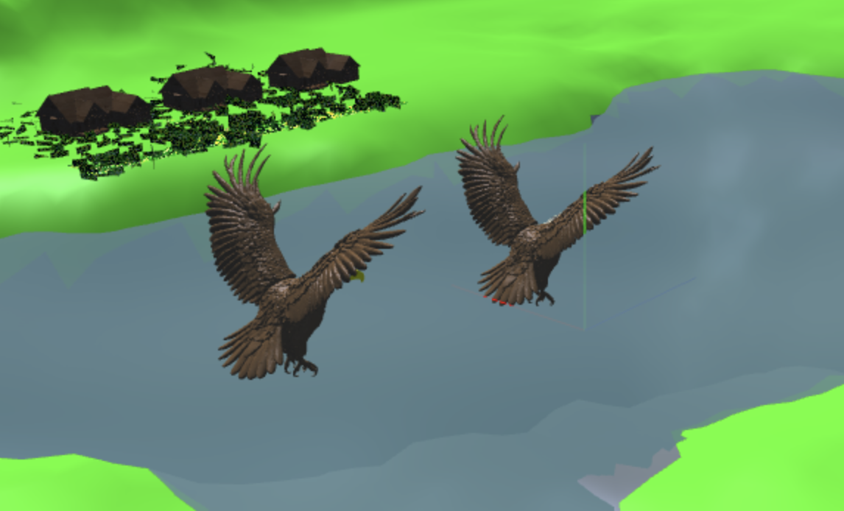
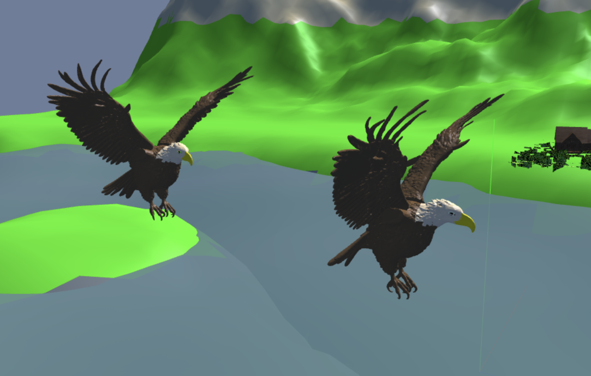
Interactivity (Any 2) Interactive camera controls (fly-through, object focus)

Slide 27
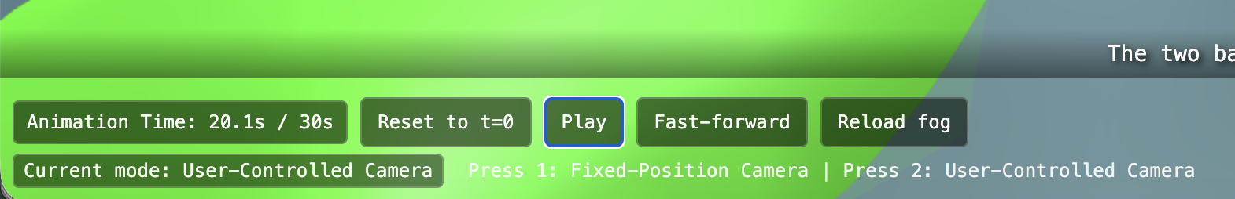
Interactivity (Any 2) Time control (pause, speed adjustment, rewind)

Slide 28
Bonus Mark Requirements

Slide 29
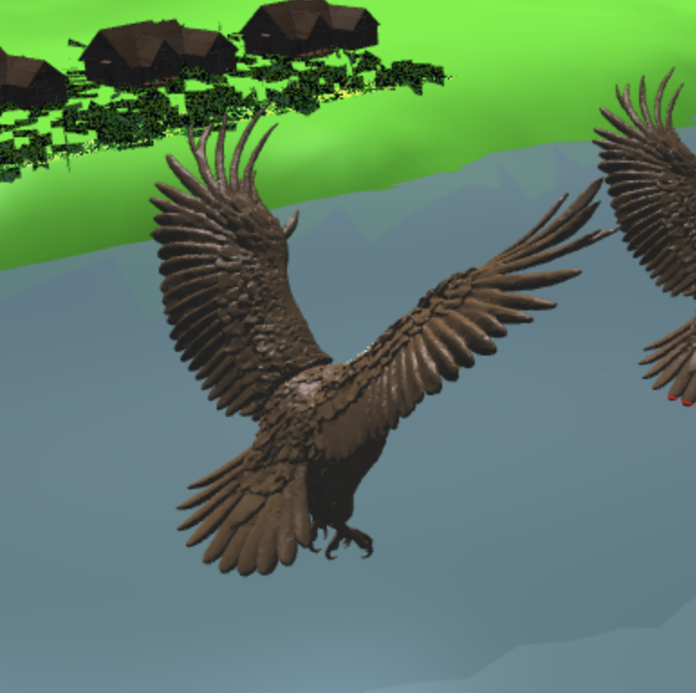
3D Character Animation 3D Bald Eagle
Articulated body parts: Body, Left Wing, Right Wing
Hierarchical skeletal structure
Parent (Base) → Children (Body parts)
2 distinct character animations
Gliding, Flapping flight
Our story is about two bald eagles
Original model generated by AI → manually refine / split / post-processing

Slide 30
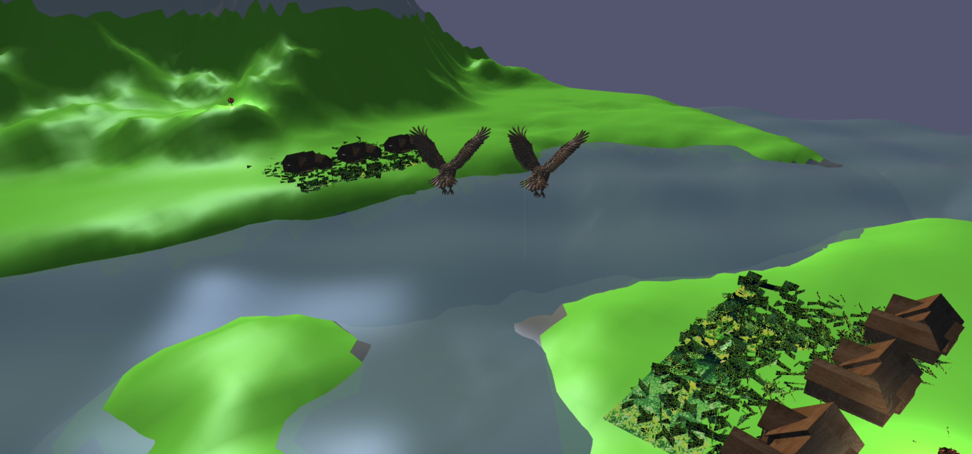
Advanced Techniques
Shadow effect
Water ripple

Slide 31
Thanks

